Slide 1
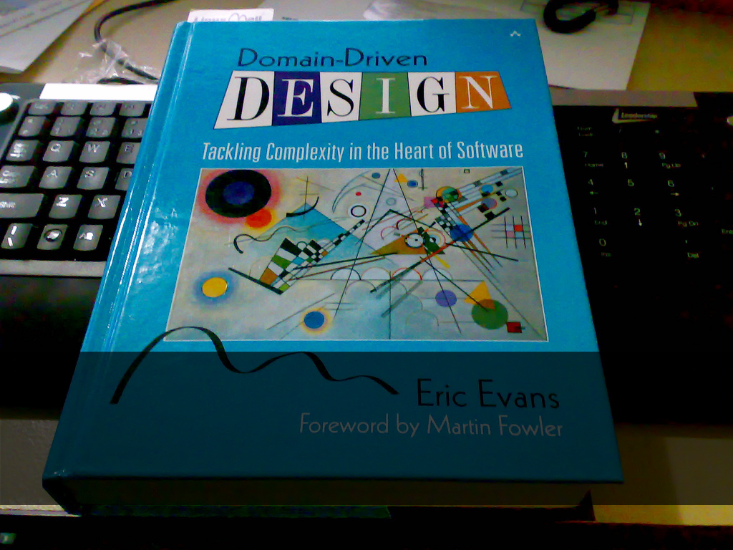
Domain Driven Design 101
Notes:
Hi guys, my name is
I'm a .NET developer at Provoke solutions
Gonna talk to you today about an introductory session to domain driven design

Slide 2
Domain Driven Design (DDD)
"Domain-driven design is not a technology or a methodology. DDD provides a structure of practices and terminology for making design decisions that focus and accelerate software projects dealing with complicated domains.“
Stackoverflow

Slide 3
Agenda
Why
Building blocks
Repositories/ORM
Entities, Value Types, Specifications etc
Putting it to practice
Dependency injection
Persistence
Validation
Architecture
Challenges
When not to use DDD

Slide 4
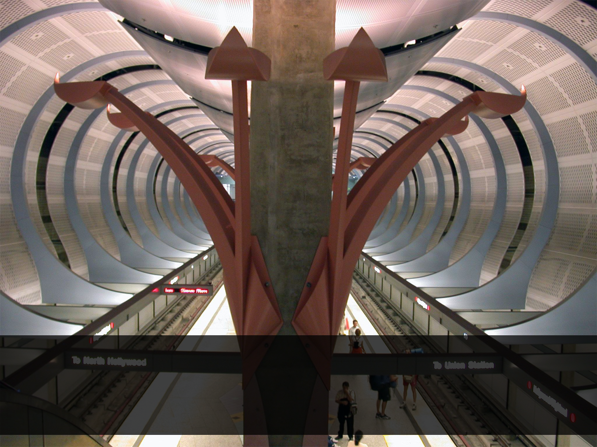
Software is complicated
Software is complicated
Notes:
-Classic 3-tier ASP.NET, datasets, stored procedures, business layer, code behind
-Introduce one new feature, break three-four others
-Pretty serious maintainability problems were making us look bad
-Nothing malicious, we had coding standards and conventions
-But business logic always ended up scattered
-Behaviour separated from data
-Impossible to unit test
-Change stuff at 3 layers

Slide 5
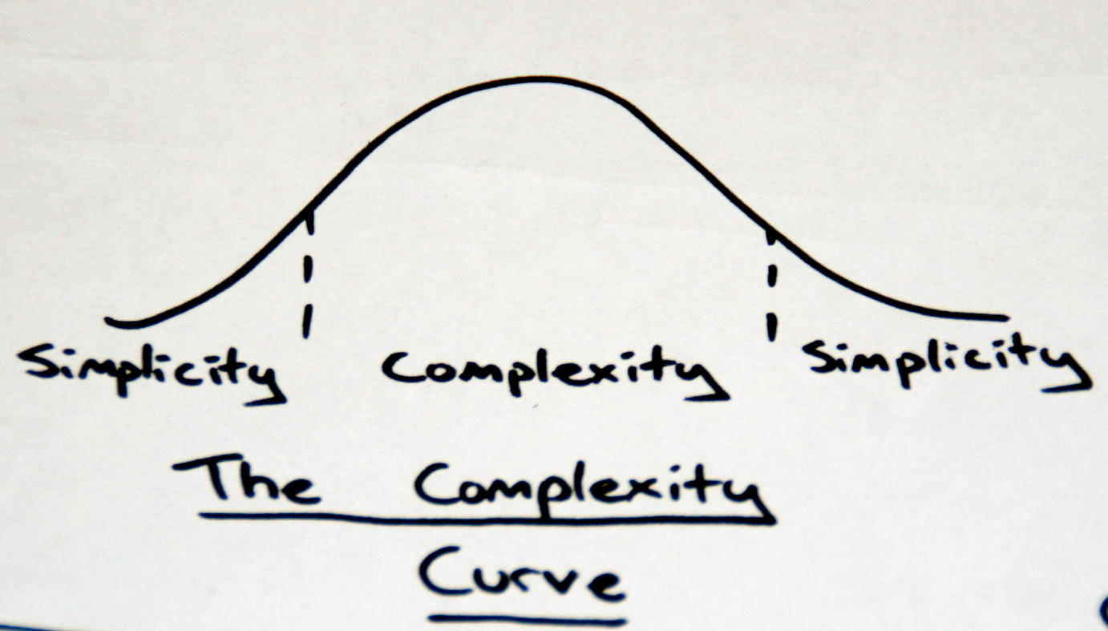
We solve complexity in software by distilling our problems
Notes:
-Complexity=enemy
-Creeps in
-Affects ability to deliver
-Separate concerns
-Breaking into smaller units
-DDD is about distilling into an explicit model
-All in one place
-Easier to work with than sprocs/code behind

Slide 6
Notes:
-Not complicated
-Important business concept hidden
-Not just anonymous calculation
-Overbooking policy
-2nd example doesn’t need comments
-DDD is about making concepts explicit
-As separate objects

